Slide 1
INX Future Employee Performance Project
Done By:
Debanjan Chowdhury

Slide 2
Problem Statement
INX Future Inc , (referred as INX ) , is one of the leading data analytics and automation solutions provider with over 15 years of global business presence. INX is consistently rated as top 20 best employers past 5 years. INX human resource policies are considered as employee friendly and widely perceived as best practices in the industry.
Recent years, the employee performance indexes are not healthy and this is becoming a growing concerns among the top management. There has been increased escalations on service delivery and client satisfaction levels came down by 8 percentage points.
CEO, Mr. Brain, knows the issues but concerned to take any actions in penalizing non-performing employees as this would affect the employee morale of all the employees in general and may further reduce the performance. Also, the market perception best employer and thereby attracting best talents to join the company.
Mr. Brain decided to initiate a data science project , which analyses the current employee data and find the core underlying causes of this performance issues. Mr. Brain, being a data scientist himself, expects the findings of this project will help him to take right course of actions. He also expects a clear indicators of non performing employees, so that any penalization of non-performing employee, if required, may not significantly affect other employee morals.

Slide 3
Key Points
Employee performance indexes are not healthy.
Increased escalations in service delivery.
Client satisfaction levels came down by 8 percentage points.

Slide 4
Data Analysis
Categorical Features:
Feature Name | Meaning
EmpNumber | Employee Number
Gender | Employee Gender
EducationBackground | Employee Education Background
MaritalStatus | Employee Marital Status
EmpDepartment | Employee Department
EmpJobRole | Job Role of the Employee
BusinessTravelFrequency | Travel Frequency for Business purpose
OverTime | Worked Over Time
Attrition | Attrition

Slide 5
Data Analysis
Numerical Features
Feature Name | Meaning
Age | Employee age
DistanceFromHome | Distance of office from home
EmpEducationLevel | Level of education
EmpEnvironmentSatisfaction | Employee environment satisfaction
EmpHourlyRate | Hourly rate of employee
EmpJobInvolvement | Job Involvement of Employee
EmpJobLevel | Job level of Employee
EmpJobSatisfaction | Job satisfaction of Employee
NumCompaniesWorked | Number of companies worked

Slide 6
Data Analysis
Numerical Features
Feature Name | Meaning
EmpLastSalaryHikePercent | Employee last salary hike percentage
EmpRelationshipSatisfaction | Employee Relationship satisfaction
TotalWorkExperienceInYears | Total work experience in years
TrainingTimesLastYear | Training times last year
EmpWorkLifeBalance | Employee work life balance
ExperieneYearsAtThisCompany | Experience years at this company
ExperienceYearsInCurrentRole | Experience years in current role
YearsSinceLastPromotion | Years since last promotion
YearsWithCurrentManager | Years with current manager
PerformanceRating | Employee Performance Rating

Slide 7
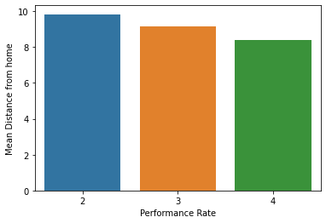
Data Visualization(Numerical Features)
DistanceFromHome vs PerformanceRate
PerformanceRating | DistanceFromHome
2 | 9.835052
3 | 9.137300
4 | 8.371212

Slide 8
Explananation
We can see from the bar graph that those who are having longer distances from home are performing low. Maybe because of longer distance, employees are not getting proper rest which is affecting their performance.

Slide 9
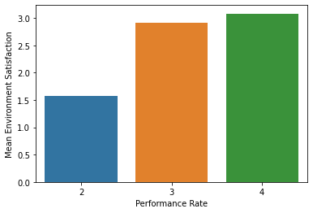
Data Visualization(Numerical Features)
EmpEnvironmentSatisfaction vs PerformanceRate
PerformanceRating | EmpEnvironmentSatisfaction
2 | 1.582474
3 | 2.911899
4 | 3.083333

Slide 10
Explananation
We can see from the bar graph that those who are less satisfied with the employee environment are performing low. Maybe they are having some problems with their working environment.

Slide 11
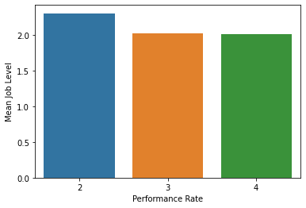
Data Visualization(Numerical Features)
EmpJobLevel vs PerformanceRate
PerformanceRating | EmpJobLevel
2 | 2.304124
3 | 2.022883
4 | 2.015152

Slide 12
Explananation
We can see from the bar graph that those whose job level is high are performing low. Maybe those people are not trained properly for such a high level of job.

Slide 13
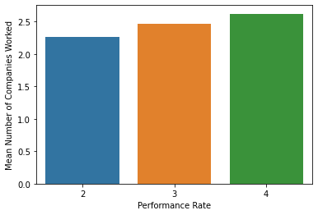
Data Visualization(Numerical Features)
NumCompaniesWorked vs PerformanceRate
PerformanceRating | NumCompaniesWorked
2 | 2.259459
3 | 2.467532
4 | 2.627907

Slide 14
Explananation
We can see from the bar graph that those who have worked in less companies are having low performance. Maybe it is because of their less work experience, they are performing low.

Slide 15
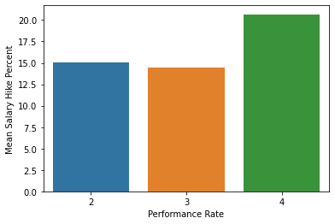
Data Visualization(Numerical Features)
EmpLastSalaryHikePercent vs PerformanceRate
PerformanceRating | EmpLastSalaryHikePercent
2 | 15.072165
3 | 14.427918
4 | 20.704545

Slide 16
Explananation
Maybe because of less salary hike, they have underperformed.

Slide 17
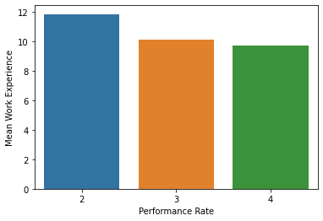
Data Visualization(Numerical Features)
TotalWorkExperienceInYears vs PerformanceRate
PerformanceRating | TotalWorkExperienceInYears
2 | 11.844086
3 | 10.168258
4 | 9.704000

Slide 18
Explananation
It is seen that those who are having more work experience, they are under performing. Maybe because they are more aged, so they are not very much well skilled with the modern technology.
Also it might be a reason that becuse of much higher experience, they tend to develop some overconfidence.

Slide 19
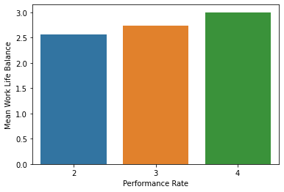
Data Visualization(Numerical Features)
EmpWorkLifeBalance vs PerformanceRate
PerformanceRating | EmpWorkLifeBalance
2 | 2.634021
3 | 2.731121
4 | 2.992424

Slide 20
Explananation
It is seen that those whose work life balance value is less, they have under performed. It might be because they might be having some problems with their life and because of that they are not able to give their best.

Slide 21
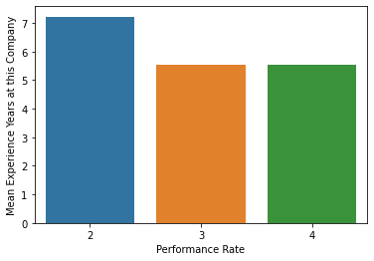
Data Visualization(Numerical Features)
ExperienceYearsAtThisCompany vs PerformanceRate
PerformanceRating | ExperienceYearsAtThisCompany
2 | 7.770950
3 | 5.889286
4 | 5.616000

Slide 22
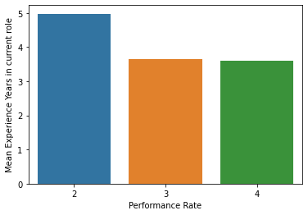
Data Visualization(Numerical Features)
ExperienceYearsInCurrentRole vs PerformanceRate
PerformanceRating | ExperienceYearsInCurrentRole
2 | 5.406417
3 | 3.904268
4 | 3.807692

Slide 23
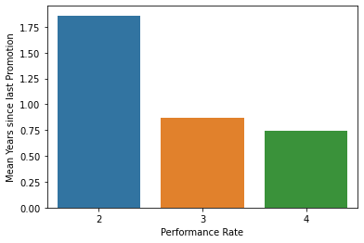
Data Visualization(Numerical Features)
YearsSinceLastPromotion vs PerformanceRate
PerformanceRating | YearsSinceLastPromotion
2 | 2.642857
3 | 1.279609
4 | 1.272000

Slide 24
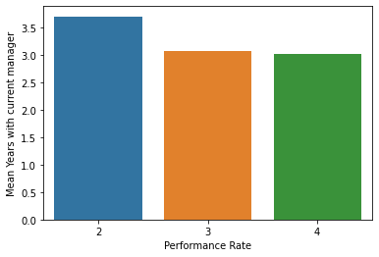
Data Visualization(Numerical Features)
YearsWithCurrentManager vs PerformanceRate
PerformanceRating | YearsWithCurrentManager
2 | 5.295337
3 | 3.745958
4 | 3.700000

Slide 25
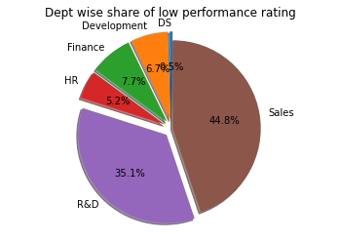
Data Visualization(Categorical Features)
EmpDepartment wise low Performance
EmpDepartment | Percentage
Sales | 44.8%
R&D | 35.1%
Finance | 7.7%
Development | 6.7%
HR | 5.2%
Data Science | 0.5%

Slide 26
Analysing R&D Department
Numerical features considered:
Age
DistanceFromHome
EmpEducationLevel
EmpEnvironmentSatisfaction
EmpJobLevel
NumCompaniesWorked
EmpRelationshipSatisfaction

Slide 27
Analysing R&D Department
Numerical features considered:
TotalWorkExperienceInYears
EmpWorkLifeBalance
ExperieneYearsAtThisCompany
YearsSinceLastPromotion
YearsWithCurrentManager

Slide 28
Analysing R&D Department
Categorial features considered:
EducationBackground
MaritalStatus
Attrition

Slide 29
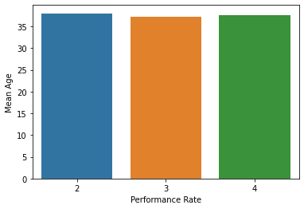
Data Visualization(Numerical Features)
Age vs PerformanceRate
PerformanceRating | Age
2 | 38.014706
3 | 37.282051
4 | 37.682927

Slide 30
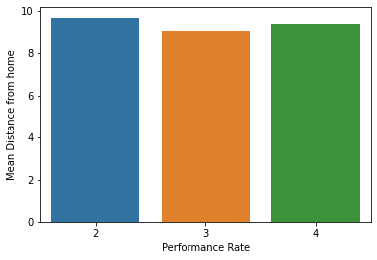
Data Visualization(Numerical Features)
DistanceFromHome vs PerformanceRate
PerformanceRating | DistanceFromHome
2 | 9.691176
3 | 9.064103
4 | 9.414634

Slide 31
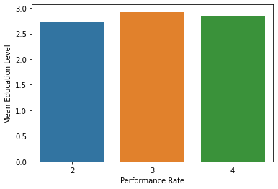
Data Visualization(Numerical Features)
EmpEducationLevel vs PerformanceRate
PerformanceRating | EmpEducationLevel
2 | 2.720588
3 | 2.923077
4 | 2.853659

Slide 32
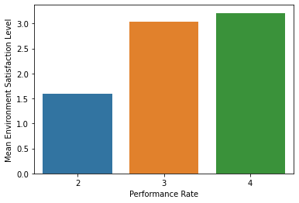
Data Visualization(Numerical Features)
EmpEnvironmentSatisfaction vs PerformanceRate
PerformanceRating | EmpEnvironmentSatisfaction
2 | 1.602941
3 | 3.038462
4 | 3.219512

Slide 33
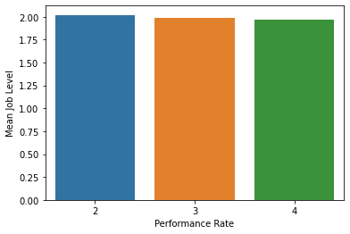
Data Visualization(Numerical Features)
EmpJobLevel vs PerformanceRate
PerformanceRating | EmpJobLevel
2 | 2.029412
3 | 1.991453
4 | 1.975610

Slide 34
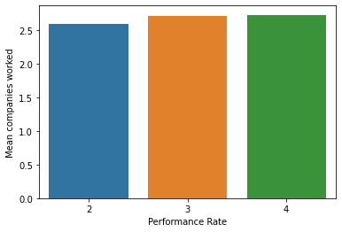
Data Visualization(Numerical Features)
NumCompaniesWorked vs PerformanceRate
PerformanceRating | NumCompaniesWorked
2 | 2.602941
3 | 2.713675
4 | 2.731707

Slide 35
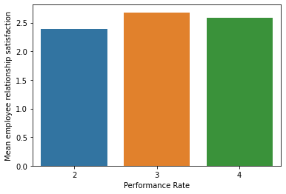
Data Visualization(Numerical Features)
EmpRelationshipSatisfaction vs PerformanceRate
PerformanceRating | EmpRelationshipSatisfaction
2 | 2.397059
3 | 2.683761
4 | 2.585366

Slide 36
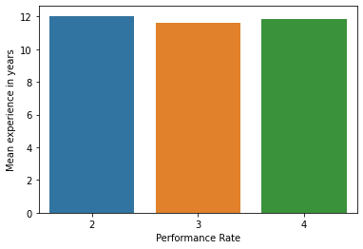
Data Visualization(Numerical Features)
TotalWorkExperienceInYears vs PerformanceRate
PerformanceRating | TotalWorkExperienceInYears
2 | 12.044118
3 | 11.645299
4 | 11.829268

Slide 37
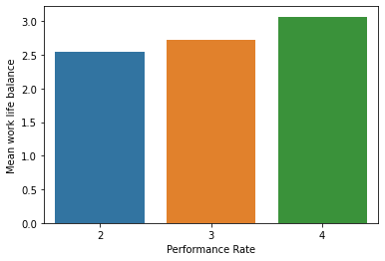
Data Visualization(Numerical Features)
EmpWorkLifeBalance vs PerformanceRate
PerformanceRating | EmpWorkLifeBalance
2 | 2.558824
3 | 2.739316
4 | 3.073171

Slide 38
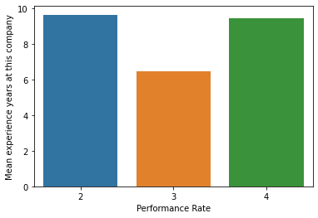
Data Visualization(Numerical Features)
ExperienceYearsAtThisCompany vs PerformanceRate
PerformanceRating | ExperienceYearsAtThisCompany
2 | 9.666667
3 | 6.470120
4 | 9.485714

Slide 39
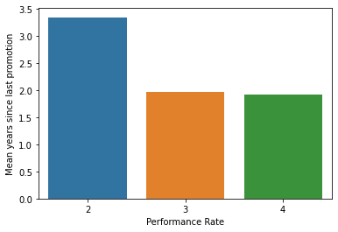
Data Visualization(Numerical Features)
YearsSinceLastPromotion vs PerformanceRate
PerformanceRating | YearsSinceLastPromotion
2 | 3.352941
3 | 1.978632
4 | 1.926829

Slide 40
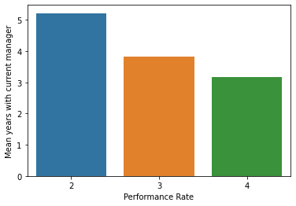
Data Visualization(Numerical Features)
YearsWithCurrManager vs PerformanceRate
PerformanceRating | YearsWithCurrManager
2 | 5.220588
3 | 3.833333
4 | 3.170732

Slide 41
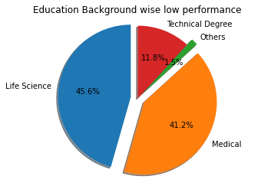
Data Visualization(Categorical Features)
EducationBackground wise low performance
EmpBackground | Percentage
Life Science | 45.6%
Medical | 41.2%
Technical Degree | 11.8%
Others | 1.5%

Slide 42
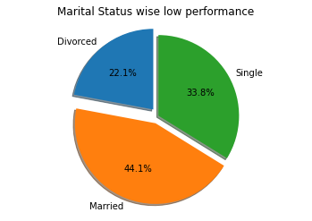
Data Visualization(Categorical Features)
MaritalStatus wise low performance
MaritalStatus | Percentage
Married | 44.1%
Single | 33.8%
Divorced | 22.1%

Slide 43
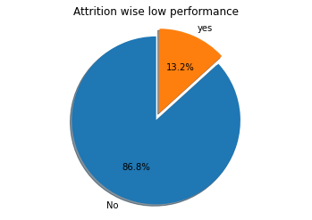
Data Visualization(Categorical Features)
Attrition wise low performance
Attrition | Percentage
No | 86.8%
Yes | 13.2%

Slide 44
Analysing R&D Department
Numerical features considered:
Age
DistanceFromHome
EmpEnvironmentSatisfaction
EmpJobInvolvement
EmpJobLevel
EmpJobSatisfaction
TotalWorkExperienceInYears

Slide 45
Analysing R&D Department
Numerical features considered:
EmpWorkLifeBalance
ExperieneYearsAtThisCompany
ExperienceYearsInCurrentRole
YearsSinceLastPromotion
YearsWithCurrentManager

Slide 46
Analysing R&D Department
Categorial features considered:
EducationBackground
MaritalStatus
Attrition

Slide 47
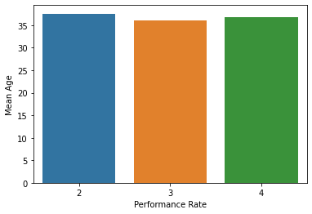
Data Visualization(Numerical Features)
Age vs PerformanceRate
PerformanceRating | Age
2 | 37.574713
3 | 36.031873
4 | 36.714286

Slide 48
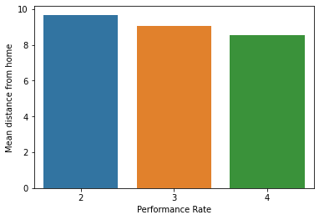
Data Visualization(Numerical Features)
DistanceFromHome vs PerformanceRate
PerformanceRating | DistanceFromHome
2 | 9.689655
3 | 9.063745
4 | 8.542857

Slide 49
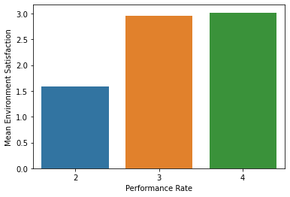
Data Visualization(Numerical Features)
EmpEnvironmentSatisfaction vs PerformanceRate
PerformanceRating | EmpEnvironmentSatisfaction
2 | 1.586207
3 | 2.968127
4 | 3.028571

Slide 50
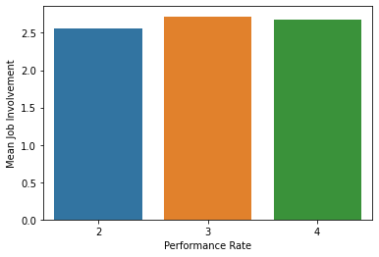
Data Visualization(Numerical Features)
EmpJobInvolvement vs PerformanceRate
PerformanceRating | EmpJobInvolvement
2 | 2.563218
3 | 2.725100
4 | 2.685714

Slide 51
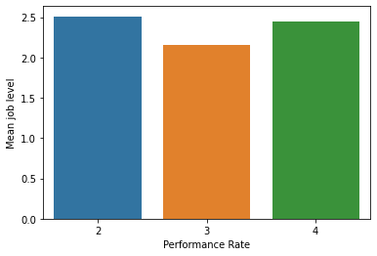
Data Visualization(Numerical Features)
EmpJobLevel vs PerformanceRate
PerformanceRating | EmpJobLevel
2 | 2.517241
3 | 2.163347
4 | 2.457143

Slide 52
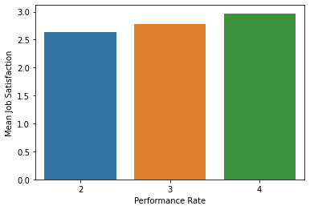
Data Visualization(Numerical Features)
EmpJobSatisfaction vs PerformanceRate
PerformanceRating | EmpJobLevel
2 | 2.632184
3 | 2.784861
4 | 2.971429

Slide 53
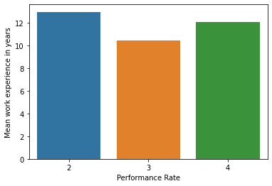
Data Visualization(Numerical Features)
TotalWorkExperienceInYears vs PerformanceRate
PerformanceRating | TotalWorkExperienceInYears
2 | 12.977011
3 | 10.462151
4 | 12.085714

Slide 54

Data Visualization(Numerical Features)
EmpWorkLifeBalance vs PerformanceRate
PerformanceRating | EmpWorkLifeBalance
2 | 2.678161
3 | 2.800797
4 | 3.057143

Slide 55
Data Visualization(Numerical Features)
ExperienceYearsAtThisCompany vs PerformanceRate
PerformanceRating | ExperienceYearsAtThisCompany
2 | 9.666667
3 | 6.470120
4 | 9.485714

Slide 56
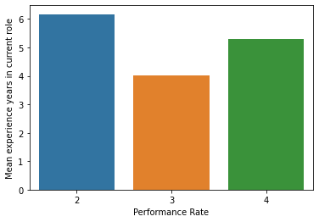
Data Visualization(Numerical Features)
ExperienceYearsInCurrentRole vs PerformanceRate
PerformanceRating | ExperienceYearsAtThisCompany
2 | 6.172414
3 | 4.023904
4 | 5.314286

Slide 57
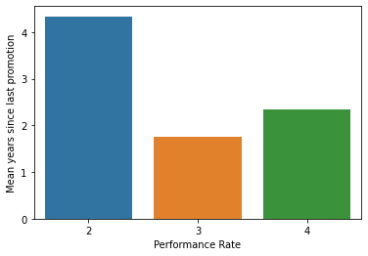
Data Visualization(Numerical Features)
YearsSinceLastPromotion vs PerformanceRate
PerformanceRating | YearsSinceLastPromotion
2 | 4.344828
3 | 1.756972
4 | 2.342857

Slide 58
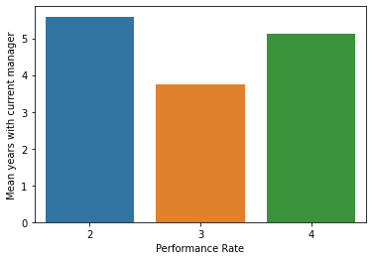
Data Visualization(Numerical Features)
YearsWithCurrentManager vs PerformanceRate
PerformanceRating | YearsWithCurrentManager
2 | 5.597701
3 | 3.768924
4 | 5.114286

Slide 59
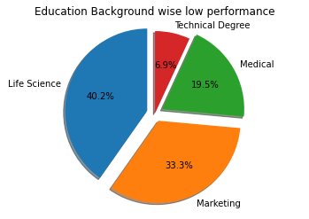
Data Visualization(Categorical Features)
EducationBackground wise low performance
EmpBackground | Percentage
Life Science | 40.2%
Marketing | 33.3%
Medical | 19.5%
Technical Degree | 6.9%

Slide 60
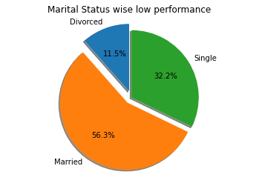
Data Visualization(Categorical Features)
MaritalStatus wise low performance
MaritalStatus | Percentage
Married | 56.3%
Single | 32.2%
Divorced | 11.5%

Slide 61
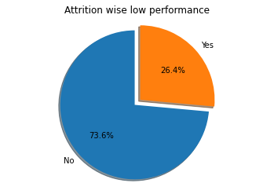
Data Visualization(Categorical Features)
Attrition wise low performance
Attrition | Percentage
No | 73.6%
Yes | 26.4%

Slide 62
Thank You

